Slide 1
The Safety Net for Children with Diabetes in the US
The Children with Special Health Care Needs Program, funded through Title V of the Social Security Act of 1935, serves as a safety net for children with chronic diseases in the US, but the availability of coverage varies across states. In 2006, we contacted Title V Programs in all 50 states to look at how coverage for children with diabetes varies across states.
The red states offer provide coordination of care but do not provide medical coverage.
The blue states provide medical coverage but this coverage varies by state.
This is an interactive map. Click on individual states to explore the variation.
State-to-State Variability in Title V Coverage for Children with Diabetes.
Wolfgram PM, Sarrault J, Clark S, Lee JM.
J Pediatr. 2013 Jan 13. doi:pii: S0022-3476(12)01455-2. 10.1016/j.jpeds.2012.12.009. [Epub ahead of print]

Slide 2
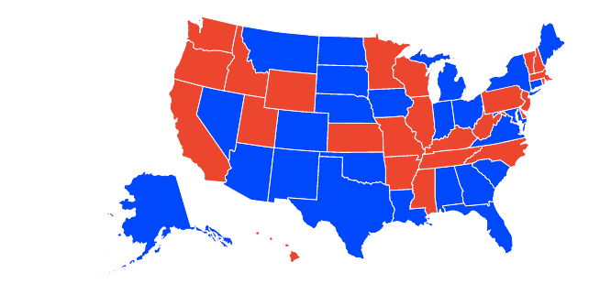

Slide 3

Virginia
Provides medical coverage and coordination of care for children with diabetes
The maximum age of eligibility is 21 years.
The income requirement for families for the Title V Program
is an income below the Federal Poverty Limit of 300%
In comparison, the income requirement for other programs in this state are 200% for the State Children’s Medical Insurance Program and 100% for Medicaid
The maximum coverage cap for Title V is: $10,000/admission with a lifetime maximum of $50,000
This program provides coverage for:
Visits with a Medical Provider
Visits with a Dietician
Diabetes Education
Mental Health
Transportation
Insulin

Slide 4
Virginia
Provides medical coverage and coordination of care for children with diabetes
The maximum age of eligibility is 21 years.
The income requirement for families for the Title V Program
is an income below the Federal Poverty Limit of 300%
In comparison, the income requirement for other programs in this state are 200% for the State Children’s Medical Insurance Program and 100% for Medicaid
The maximum coverage cap for Title V is: $10,000/admission with a lifetime maximum of $50,000
This program provides coverage for:
Visits with a Medical Provider
Visits with a Dietician
Diabetes Education
Mental Health
Transportation
Insulin

Slide 5
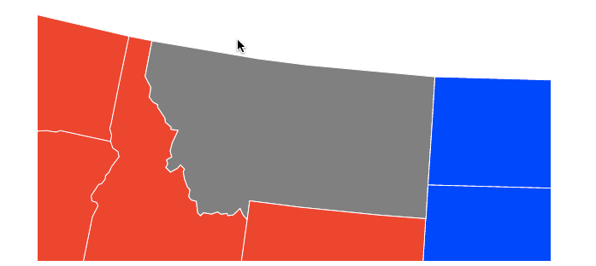
Montana
Only provides coordination of care for children with diabetes

